Slide 1
Semantic Analysis: Syntax Directed Translation
CSE 420
Lecture 10-11

Slide 2
Program is lexically well-formed:
Identifiers have valid names.
Strings are properly terminated.
No stray characters.
Program is syntactically well-formed:
Class declarations have the correct structure.
Expressions are syntactically valid.
Does this mean that the program is legal?

Slide 3
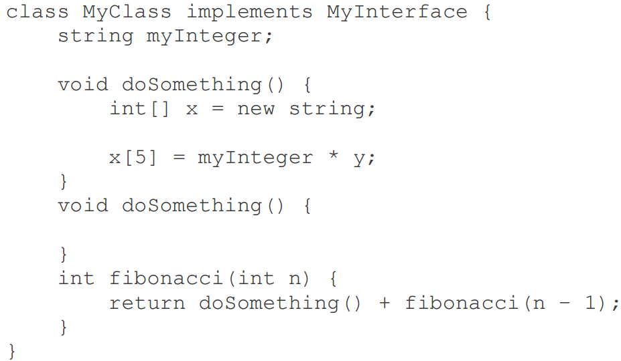

Slide 4
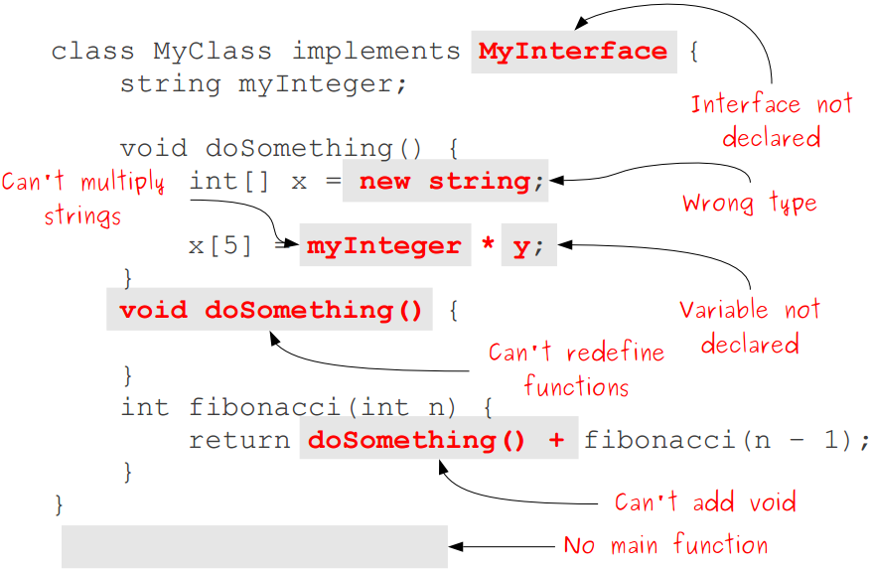

Slide 5
Semantic Analysis
Ensure that the program has a well-defined meaning.
Verify properties of the program that aren't caught during the earlier phases:
Variables are declared before they're used.
Expressions have the right types.
Arrays can only be instantiated with NewArray.
Classes don't inherit from nonexistent base classes …
Once we finish semantic analysis, we know that the user's input program is legal.

Slide 6
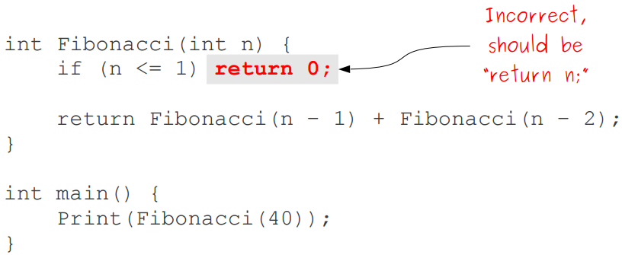
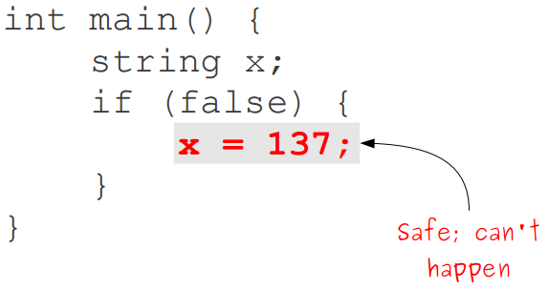
Challenges in Semantic Analysis
Reject the largest number of incorrect programs.
Accept the largest number of correct programs.
Do so quickly.

Slide 7
Other Goals of Semantic Analysis
Gather useful information about program for later phases:
Determine what variables are meant by each identifier.
Build an internal representation of inheritance hierarchies.
Count how many variables are in scope at each point

Slide 8
Semantic Analysis
Semantic Analysis computes additional information related to the meaning of the program once the syntactic structure is known.
In typed languages as C, semantic analysis involves
adding information to the symbol table and
performing type checking.
The information to be computed is beyond the capabilities of standard parsing techniques, therefore it is not regarded as syntax.
As for Lexical and Syntax analysis, also for Semantic Analysis we need both a Representation Formalism and an Implementation Mechanism.

Slide 9
Syntax Directed Translation: Intro
The Principle of Syntax Directed Translation states that the meaning of an input sentence is related to its syntactic structure, i.e., to its Parse-Tree.
By Syntax Directed Translations we indicate those formalisms for specifying translations for programming language constructs guided by context-free grammars.
We associate Attributes to the grammar symbols representing the language constructs.
Values for attributes are computed by Semantic Rules associated with grammar productions.

Slide 10
Syntax Directed Translation: Intro (Cont.)
Evaluation of Semantic Rules may:
Generate Code;
Insert information into the Symbol Table;
Perform Semantic Check;
Issue error messages; etc.

Slide 11
Syntax Directed Translation: Intro (Cont.)
There are two notations for attaching semantic rules:
Syntax Directed Definitions.
High-level specification hiding many implementation details (also called Attribute Grammars).
Translation Schemes.
More implementation oriented: Indicate the order in which semantic rules are to be evaluated.

Slide 12
Syntax Directed Definitions
Syntax Directed Definitions are a generalization of context-free grammars in which:
Grammar symbols have an associated set of Attributes;
Productions are associated with Semantic Rules for computing the values of attributes.
Such formalism generates Annotated Parse-Trees where each node of the tree is a record with a field for each attribute (e.g., X.a indicates the attribute a of the grammar symbol X).

Slide 13
Attribute Grammars
Both semantic analysis and (intermediate) code generation can be described in terms of annotation, or "decoration" of a parse or syntax tree
ATTRIBUTE GRAMMARS provide a formal framework for decorating such a tree

Slide 14
Attribute Grammars
E → E + T E → E – T E → T T → T * F T → T / F T → F F → - F F → (E) F → const
This says nothing about what the program MEANS

Slide 15
Attribute Grammars
We can turn this into an attribute grammar as follows : E → E + T E1.val = E2.val + T.val E → E – T E1.val = E2.val - T.val E → T E.val = T.val T → T * F T1.val = T2.val * F.val T → T / F T1.val = T2.val / F.val T → F T.val = F.val F → - F F1.val = - F2.val F → (E) F.val = E.val F → const F.val = C.val

Slide 16
Attribute Grammars
The attribute grammar serves to define the semantics of the input program
Attribute rules are best thought of as definitions, not assignments
They are not necessarily meant to be evaluated at any particular time, or in any particular order, though they do define their left-hand side in terms of the right-hand side
The process of evaluating attributes is called annotation, or DECORATION, of the parse tree
The code fragments for the rules are called SEMANTIC FUNCTIONS

Slide 17
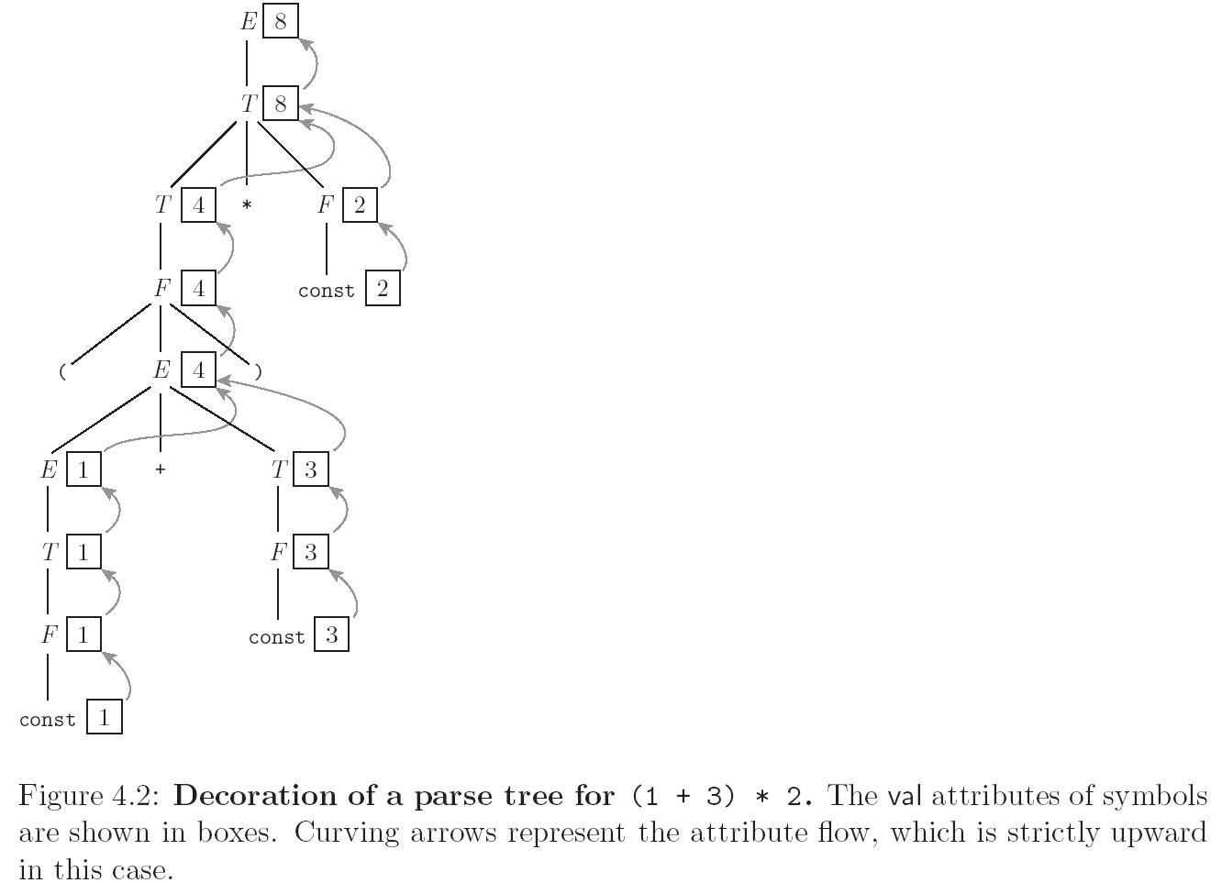
Evaluating Attributes

Slide 18
Syntax Directed Definitions (Cont.)
The value of an attribute of a grammar symbol at a given parse-tree node is defined by a semantic rule associated with the production used at that node.
We distinguish between two kinds of attributes:
Synthesized Attributes. They are computed from the values of the attributes of the children nodes.
Inherited Attributes. They are computed from the values of the attributes of both the siblings and the parent nodes.

Slide 19
Inherited and Synthesized Attributes
A synthesized attribute for a non-terminal A at a parse-tree node N is defined by
a semantic rule associated with the production at N. Note that the production must have A as its head.
A synthesized attribute at node N is defined only in terms of attribute values at the children of N and at N itself.

Slide 20
Inherited and Synthesized Attributes
An inherited attribute for a non-terminal B at a parse-tree node N is defined by
A semantic rule associated with the production at the parent of N. Note that the production must have B as a symbol in its body.
An inherited attribute at node N is defined only in terms of attribute values at N's parent, N itself, and N's siblings.

Slide 21
Inherited and Synthesized Attributes
Terminals can have synthesized attributes, which are given to it by the lexer (not the parser).
There are no rules in an SDD giving values to attributes for terminals.
Terminals do not have inherited attributes.
A non-terminal can have both inherited and synthesized attributes.

Slide 22
Evaluating an SDD at the Nodes of a Parse Tree
Parse tree helps us to visualize the translation specified by SDD.
The rules of an SDD are applied by first constructing a parse tree
then using the rules to evaluate all of the attributes at each of the nodes of the parse tree.
A parse tree, showing the value(s) of its attribute(s) is called an annotated parse tree.

Slide 23
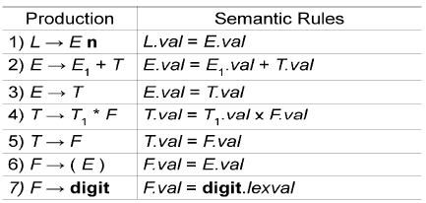
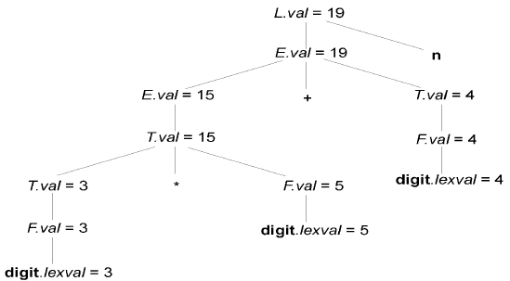
Evaluating an SDD at the Nodes of a Parse Tree
val and lexval are synthesized attributes
Annotated parse tree: 3*5 + 4 n
With synthesized attributes, we can evaluate attributes in any bottom-up order, such as that of a postorder traversal of the parse tree.

Slide 24
Evaluating an SDD at the Nodes of a Parse Tree
Inherited attributes are useful when the structure of a parse tree does not match the abstract syntax of the source code.
They can be used to overcome the mismatch due to grammar designed for parsing rather than translation.

Slide 25
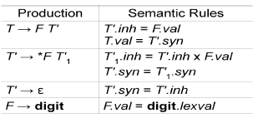
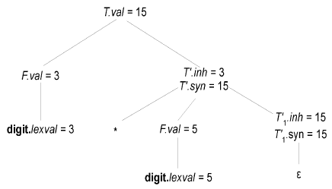
Evaluating an SDD at the Nodes of a Parse Tree
Annotated parse tree: 3*5
An SDD with both inherited and synthesized attributes does not ensure any guaranteed order; even it may not have an order at all.

Slide 26
S-Attributed Definitions
An SDD is S-attributed if every attribute is synthesized.
Attributes of an S-attributed SDD can be evaluated in bottom-up order of the nodes of parse tree.
Evaluation is simple using post-order traversal.
postorder(N) {
for (each child C of N, from the left)
postorder(C);
evaluate attributes associated with node N;
}
S-attributed definitions can be implemented during bottom-up parsing as
bottom-up parse corresponds to a postorder traversal
postorder corresponds to the order in which an LR parser reduces a production body to its head

Slide 27
L-Attributed Definitions
Each attribute must be either
Synthesized, or
Inherited, but with the rules limited as follows.
Suppose that there is a production A X₁ X₂ • • • X_{n}, there is an inherited attribute X_{i}.a computed by a rule associated with this production. Then the rule may use only:
Inherited attributes associated with the head A.
Either inherited or synthesized attributes associated with the occurrences of symbols X₁ X₂ • • • X_{i-1} located to the left of X_{i}
Inherited or synthesized attributes associated with this occurrence of X_{i} itself, but only in such a way that there are no cycles in a dependency graph formed by the attributes of this X_{i}.

Slide 28
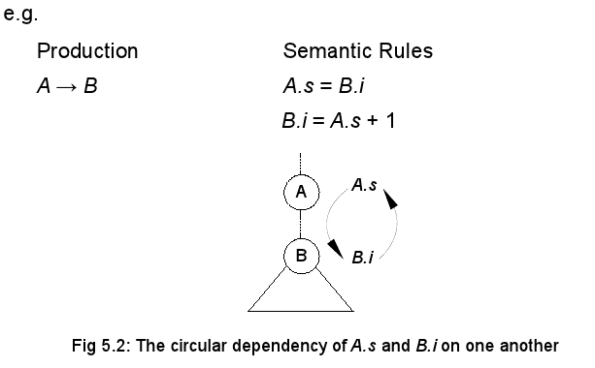
Evaluating an SDD at the Nodes of a Parse Tree

Slide 29
Evaluation Orders for SDD's
"Dependency graphs" are a useful tool for determining an evaluation order for the attribute instances in a given parse tree.
While an annotated parse tree shows the values of attributes
A dependency graph helps us determine how those values can be computed.

Slide 30
Evaluation Orders for SDD's
Each attribute is associated to a node.
If a semantic rule associated with a production p defines the value of synthesized attribute A.b in terms of the value of X.c, then graph has an edge from X.c to A.b
If a semantic rule associated with a production p defines the value of inherited attribute B.c in terms of value of X.a, then graph has an edge from X.a to B.c

Slide 31

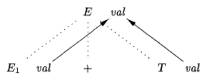
Evaluation Orders for SDD's
At every node N labeled E with children correspond to the body of production,
The synthesized attribute val at N is computed using the values of val at the two childr.en, labeled E and T

Slide 32
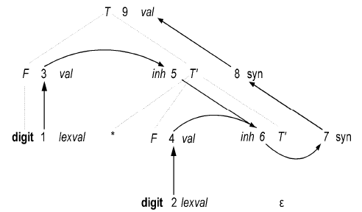
Evaluation Orders for SDD's
Dependency graph for the annotated parse tree for 3*5

Slide 33


L-Attributed Definitions-Example

Slide 34
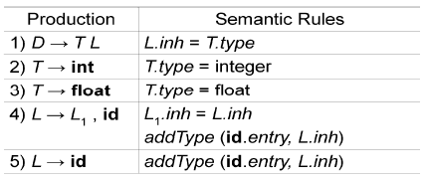
SDD For Simple Type Declarations
The purpose of L.inh is to pass the declared type down the list of identifiers, so that it can be the appropriate symbol-table entries.
Productions 2 and 3 each evaluate the synthesized attribute T.type, giving it the appropriate value, integer or float.
Productions 4 and 5 also have a rule in which a function addType is called with two arguments:
1. id.entry, a lexical value that points to a symbol-table object, and
2. L.inh, the type being assigned to every identifier on the list.
The function addType properly installs the type L.inh as the type of the represented identifier.

Slide 35
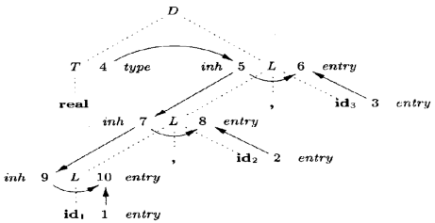
Dependency Graph For Simple Type Declarations
A dependency graph for the input string
float id1 , id 2, id3

Slide 36
Construction of Syntax Trees
SDDs are useful for is construction of syntax trees.
A syntax tree is a condensed form of parse tree.
Syntax trees are useful for representing programming language constructs like expressions and statements.
They help compiler design by decoupling parsing from translation.
Each node of a syntax tree represents a construct;
The children of the node represent the meaningful components of the construct.

Slide 37
Construction of Syntax Trees
e.g. a syntax-tree node representing an expression E₁ + E₂ has label + and two children representing the sub expressions E₁ and E₂
Each node is implemented by objects with suitable number of fields; each object will have an op field that is the label of the node with additional fields as follows:
If the node is a leaf, an additional field holds the lexical value for the leaf . This is created by function Leaf(op, val)
If the node is an interior node, there are as many fields as the node has children in the syntax tree. This is created by function Node(op, c1, c2,...,ck) .

Slide 38
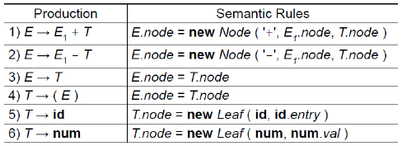
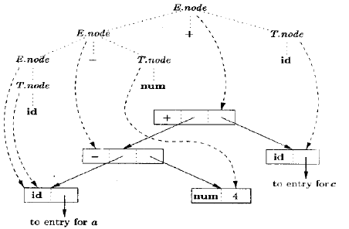
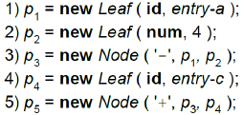
Construction of Syntax Trees

Slide 39
Constructing Syntax Trees during Top-Down Parsing
With a grammar designed for top-down parsing,
the same syntax trees are constructed,
using the same sequence of steps,
even though the structure of the parse trees differs significantly from that of syntax trees.

Slide 40
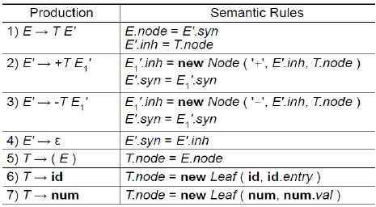
Constructing Syntax Trees during Top-Down Parsing

Slide 41
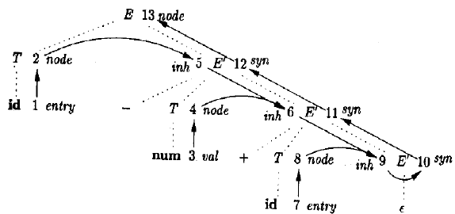
Constructing Syntax Trees during Top-Down Parsing

Slide 42
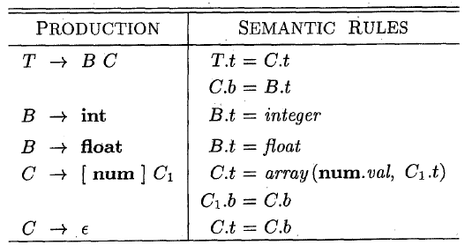

The structure of a TYPE
In C, the type int [2][3] can be read as, "array of 2 arrays of 3 integers." The corresponding type expression array(2, array(3, integer)) is represented by the tree as shown below.

Slide 43
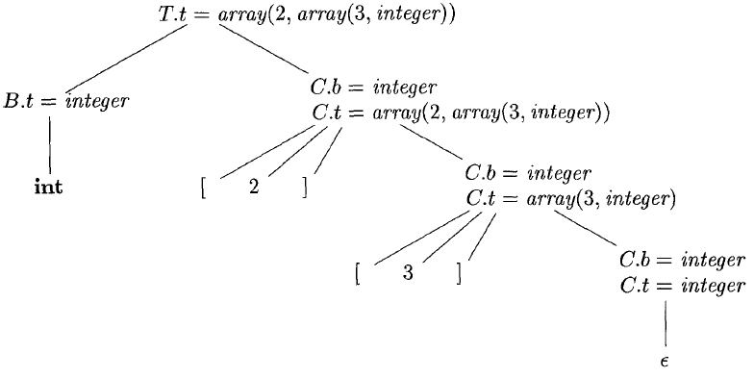
The structure of a TYPE
An annotated parse tree for the input string int [2][3] is shown below.

Slide 44
SDTs with Actions inside Productions
Action can be placed at any position in the production body.
Action is performed immediately after all symbols left to it are processed.
Given B —> X { a } Y , an action a is done after
we have recognized X (if X is a terminal), or
all terminals derived from X (if X is a nonterminal).
If bottom-up parser is used, then action a is performed as soon as X appears on top of the stack.
If top-down parser is used, then action a is performed
just before Y is expanded (if Y is nonterminal), or
check Y on input (if Y is a terminal).

Slide 45
SDTs with Actions inside Productions
Any SDT can be implemented as follows:
Ignoring actions, parse input and produce parse tree.
Add additional children to node N for action in α, where A-> α .
Perform preorder traversal of the tree, and as soon as a node labeled by an action is visited, perform that action.

Slide 46
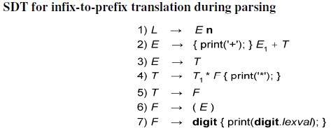
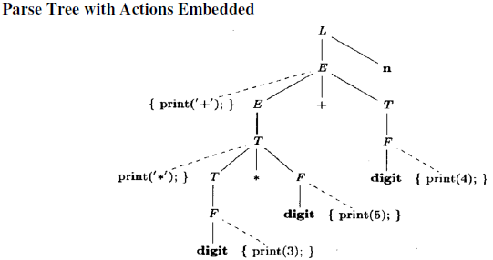
SDTs with Actions inside Productions

Slide 47
Any Question?

